Slide 1
Ancient Egypt
Introduction
Lessons 1 & 2

Slide 2
Where In The World?

Slide 3
Where in Africa?

Slide 4
Welcome to Egypt

Slide 5
Copy the Timeline into your book

Slide 6
The Nile

Slide 7
Geography
Most of Egypt is desert but along the Nile River, where Ancient Egypt was located, the soil is rich and good for growing crops.
The Nile River played an important role in shaping the lives and society of Ancient Egypt.
The Nile provided the Ancient Egyptians with food, transportation, building materials and had spiritual significance.

Slide 8
Gift of the Nile
The life source of Ancient Egypt
Three seasons
Akhet: Flood (July- October)
Peret: Growing Time (November- February)
Shemu: Drought and Harvest Time (March-June)

Slide 9
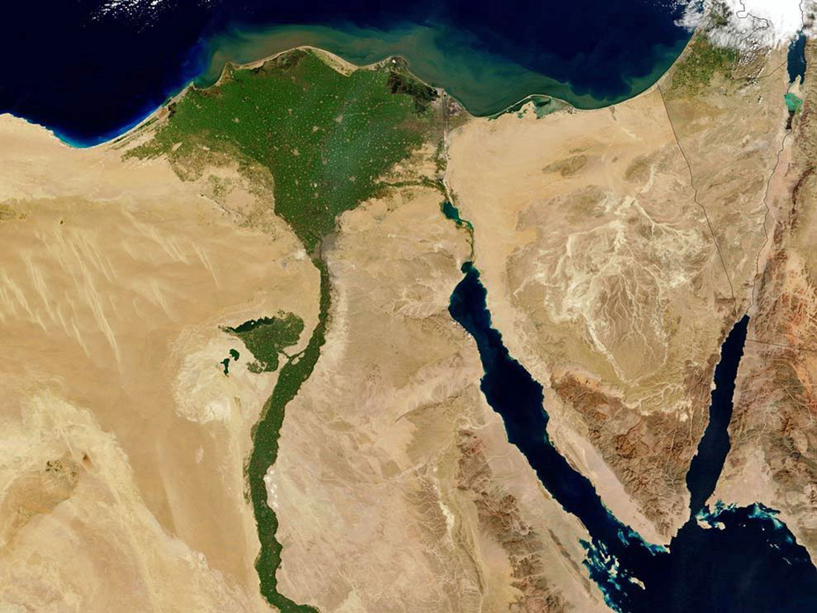

Slide 10
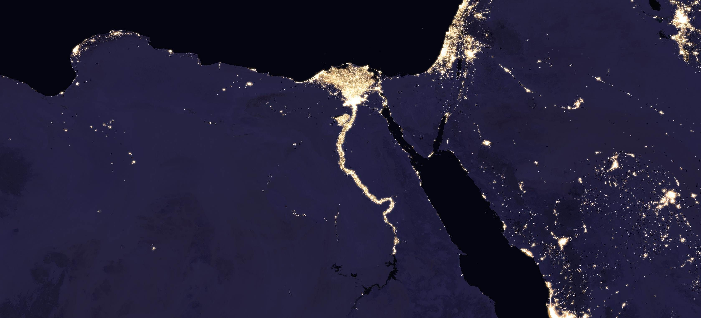

Slide 11
Mapping Activity
On your blank map label the following and glue into your book
Red Sea
Mediterranean Sea
Nile River (show the direction of the current with arrows)
Upper Egypt
Lower Egypt
Western and Eastern Sahara Desert
Nile Delta
Nubia
Sinai Peninsula
Canaan
Great Pyramid of Giza
King Tutankhamun's Tomb

